Slide 1
Domain-Driven Design Patterns

Slide 2
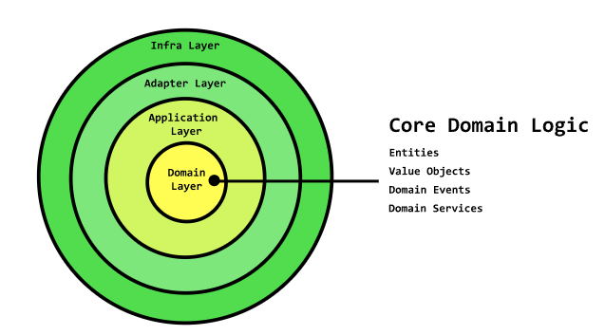
Domain-Driven Design
Domain-Driven Design (DDD) is a design philosophy and set of principles and practices for building complex software systems that are centered around the domain or business problem that the software is trying to solve. It is based on the idea that the software should be modeled after the business domain, rather than the other way around.

Slide 3
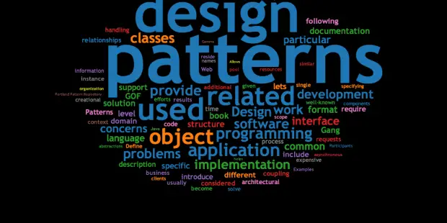
DDD Patterns
DDD patterns are design patterns that are specifically tailored to the domain-driven design approach. These patterns are used to solve common design problems that arise when building complex software systems using DDD.

Slide 4

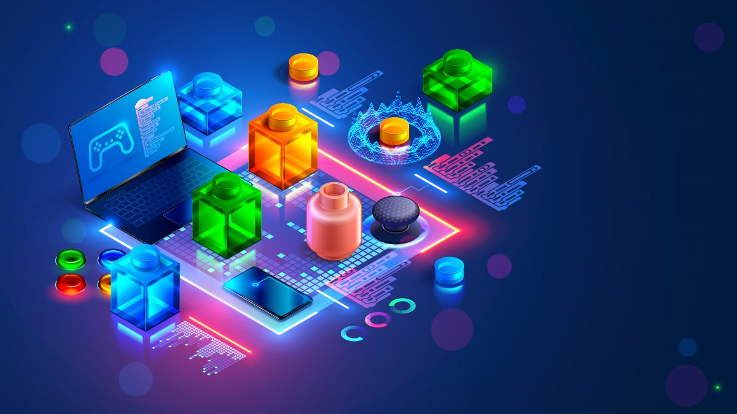
Entity
An entity is a domain object that has a unique identity and lifecycle. Entities are modeled after real-world objects that have persistent identity, such as customers, orders, and products.

Slide 5
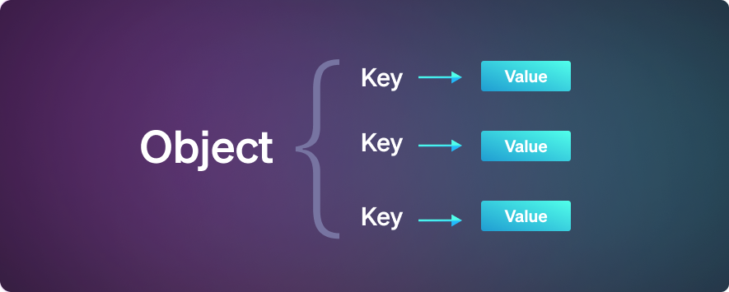
Value Object
A value object is a domain object that represents a set of values, but has no unique identity. Value objects are used to represent concepts such as dates, times, and currency.

Slide 6
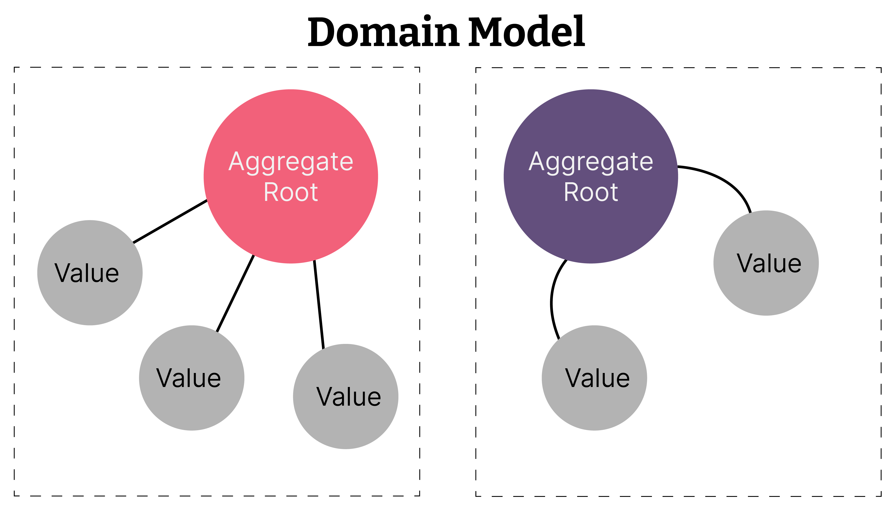
Aggregate
An aggregate is a cluster of related objects that are treated as a single unit of work. Aggregates are used to enforce consistency and transactional boundaries within the domain.

Slide 7

Repository
A repository is an abstraction layer that provides a way to persist and retrieve domain objects. Repositories are used to decouple the domain from the underlying persistence mechanism.

Slide 8
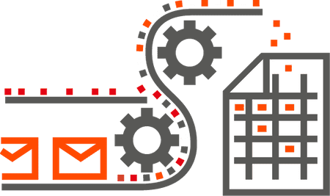
Domain Event
A domain event is a message that represents something that has happened within the domain. Domain events are used to decouple different parts of the domain and enable asynchronous communication between them.

Slide 9

Domain Service
A domain service is a stateless, domain-specific operation that doesn't naturally fit within an entity or value object. Domain services are used to encapsulate complex domain logic that doesn't belong to a single object.

Slide 10

Factory
A factory is responsible for creating complex domain objects that require a significant amount of setup or configuration. Factories are used to decouple object creation from the rest of the domain logic.

Slide 11
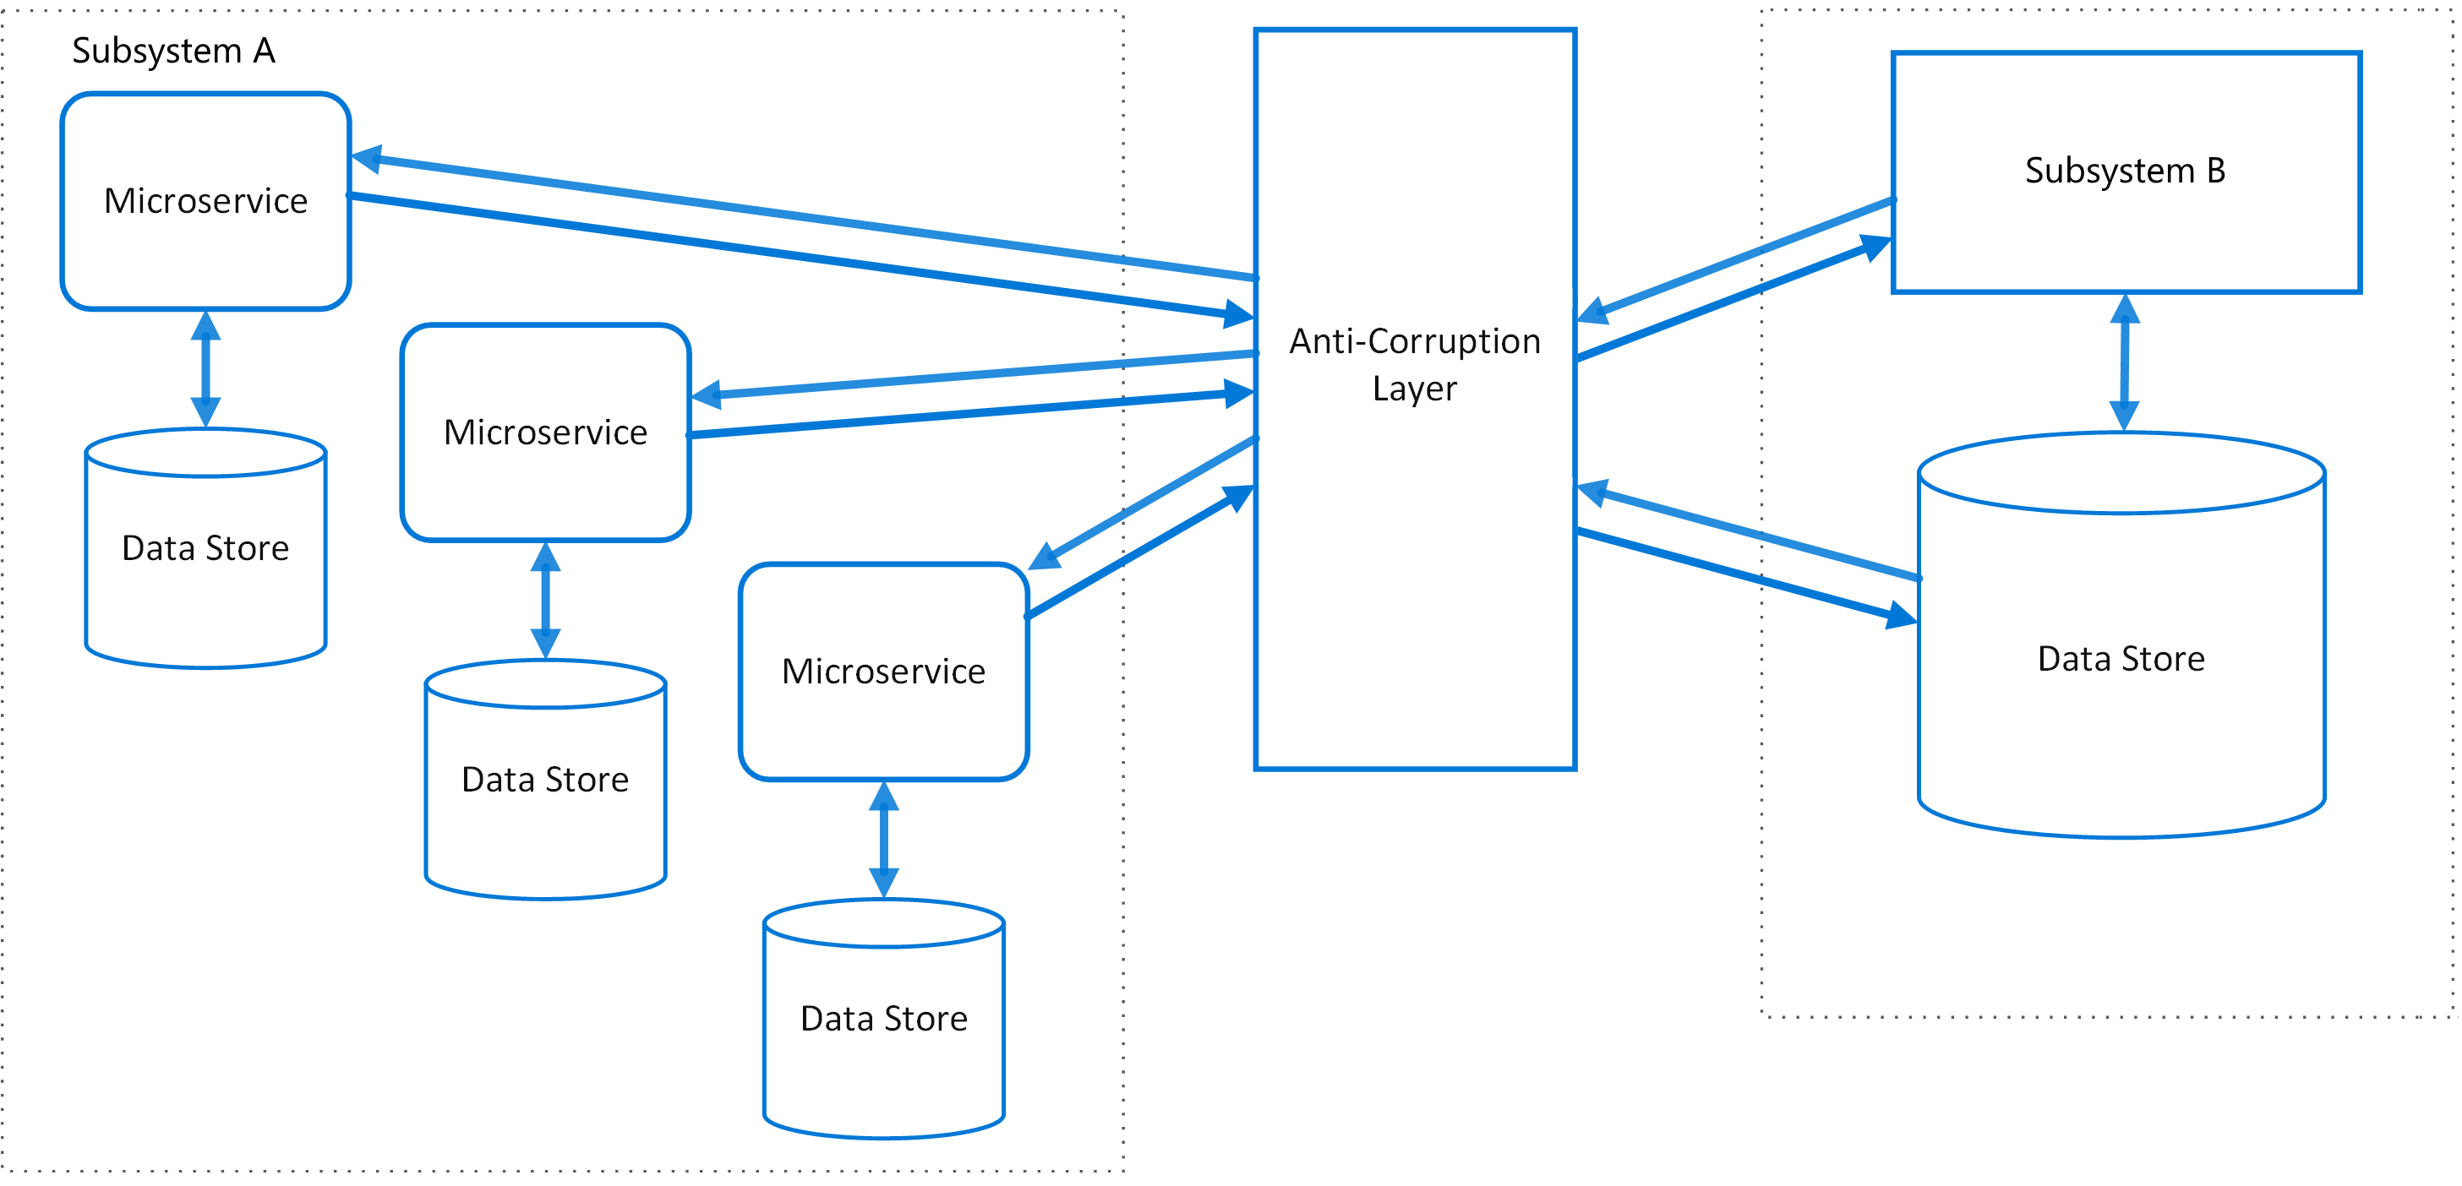
Anti-Corruption Layer
An anti-corruption layer is a set of adapters that translate data between different systems that have incompatible data models. Anti-corruption layers are used to enable integration between different systems while maintaining the integrity of the domain.

Slide 12
Conclusion
DDD patterns are specific design patterns that are tailored to the domain-driven design approach. These patterns provide developers with a set of tools for solving common design problems that arise when building complex software systems using DDD. By understanding and applying these patterns, developers can create software systems that are more flexible, adaptable, and aligned with the business domain.

Slide 13
Thanks for your attention

